Slide 1
Autonomous Car in City-Maze (Game) with Q-Learning
David A Smart
ENPM 808F – Robot Learning
Term Project
12/4/2017 - 8:40PM

Slide 2
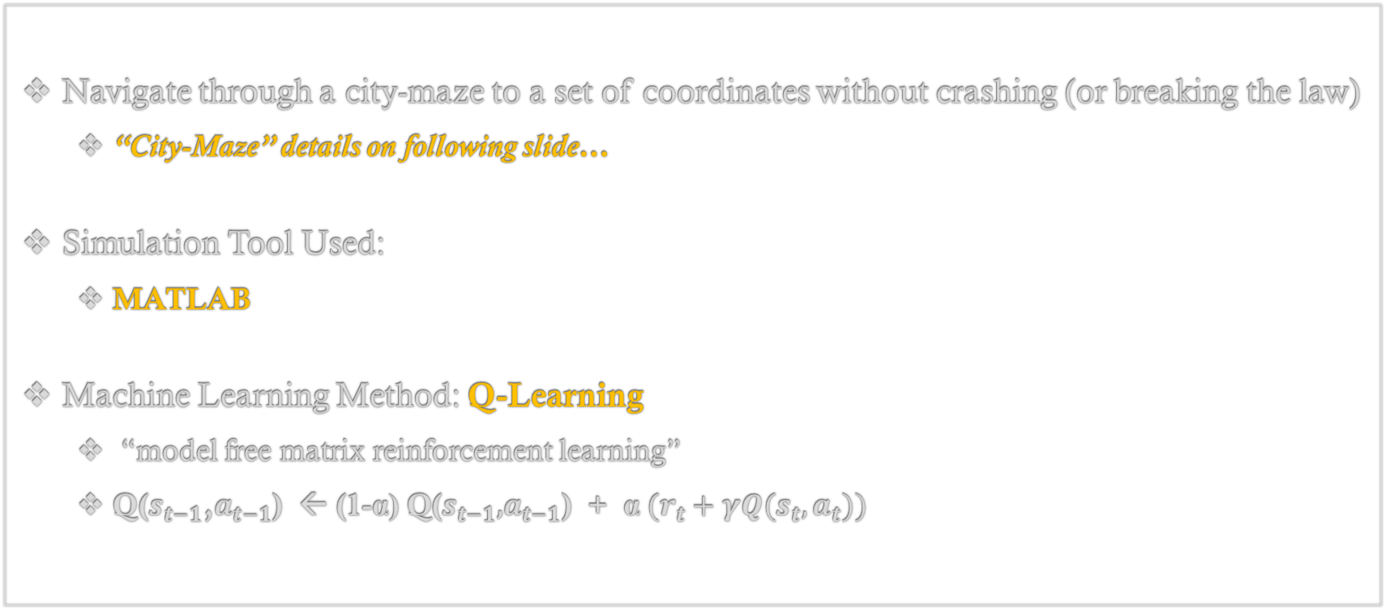
Introduction:
Navigate​​ ​through​ ​a​ ​city​-maze to a set of coordinates without crashing (or breaking the law)
“City-Maze” details on following slide…
Simulation Tool Used:
MATLAB
Machine Learning Method: Q-Learning
“model free matrix reinforcement learning”
$\text{Q}\text{(}s_{t−1}\text{,}a_{t−1}\text{) } \text{←} \text{(1−}\text{α}\text{) }\text{Q}\text{(}s_{t−1}\text{,}a_{t−1}\text{)}\text{ + }\text{α} (r_{t}+γQ(s_{t},a_{t}))$
Notes:
Reward from the state and value of current state-action pair update the value of the previous state-action pair.
$\text{α}$ – “learning rate”: weighting of update change
$γ$ – “discounting factor”: weighting of state-action pair value against reward

Slide 3
Problem Simplification:
​Stop Signs
Traffic​ ​Lights
​Two​ ​Way​ ​+ ​One​ ​Way​ Streets
​Non-learning ​Cars
Continuous Space/Movement
Differential Drive
V-REP Simulation
Sensors → State
…more like a simple game at this point
Non-learning ​Cars
Discrete Space/Movement
4 Cardinal Directions + Stop
MATLAB Simulation
Omniscient State Knowledge

Slide 4
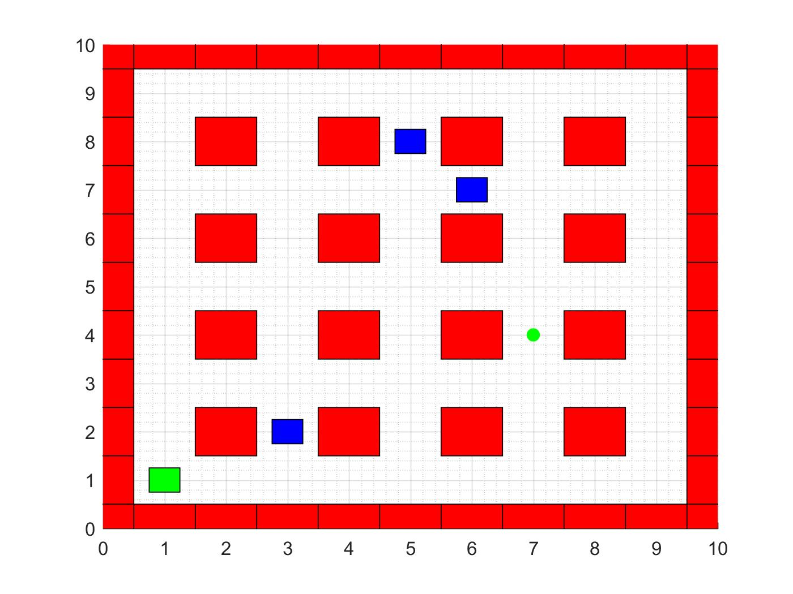
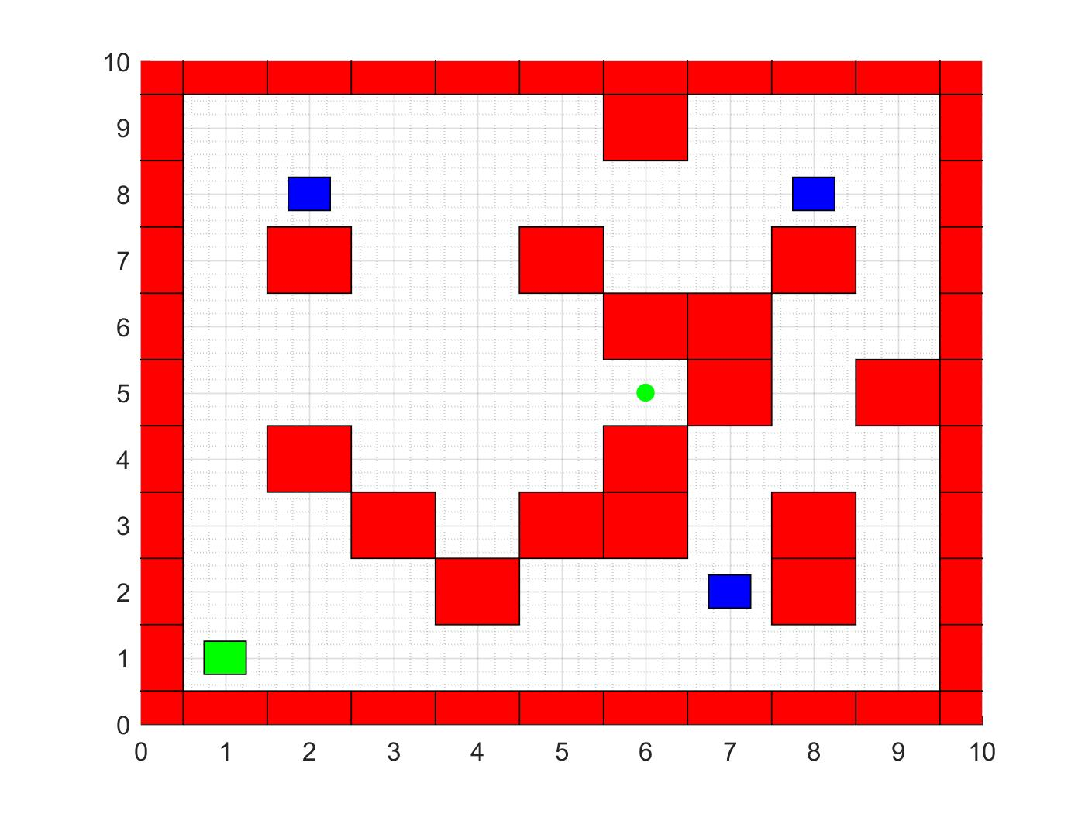
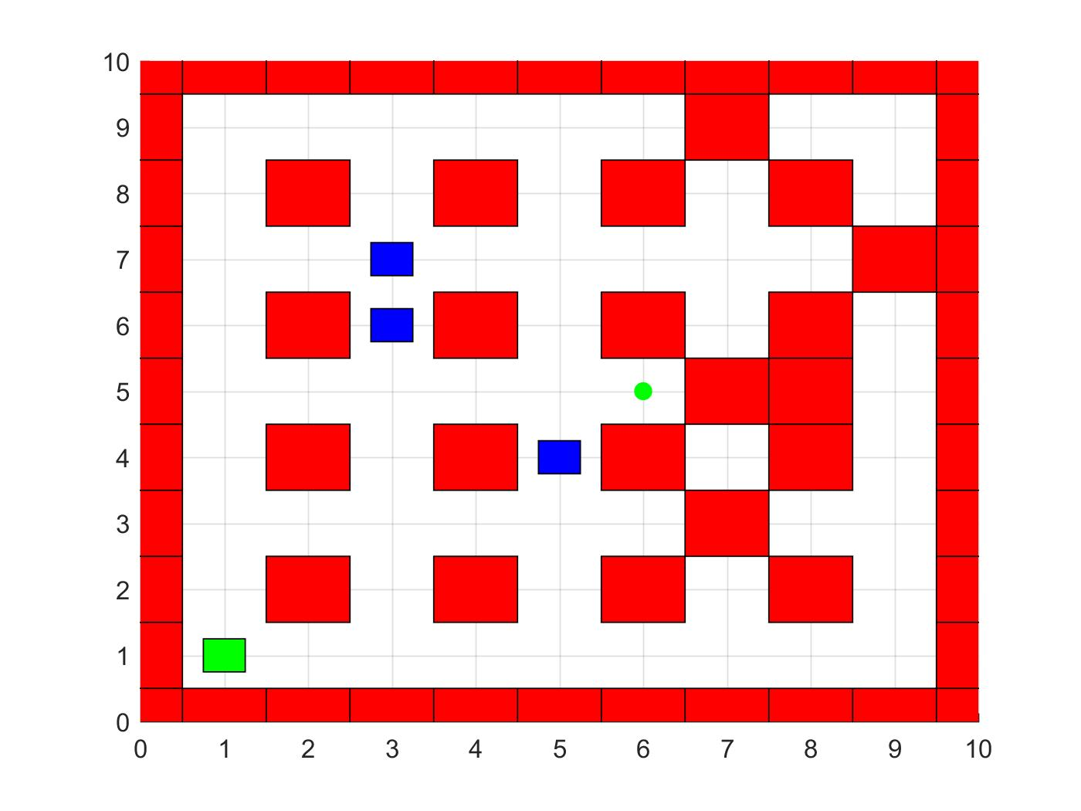
World Types:
“GRID”
“MAZE”
“GRID - MAZE”

Slide 5
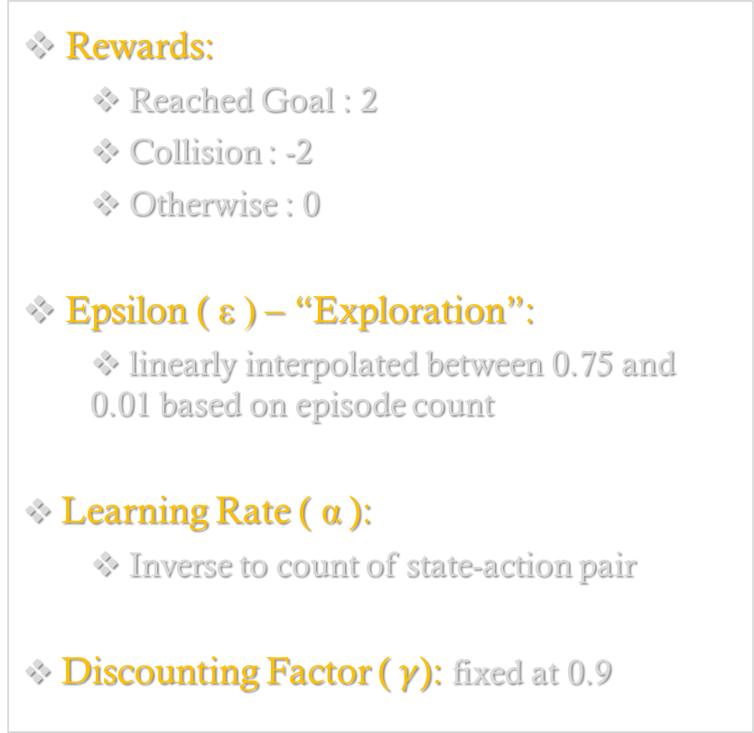
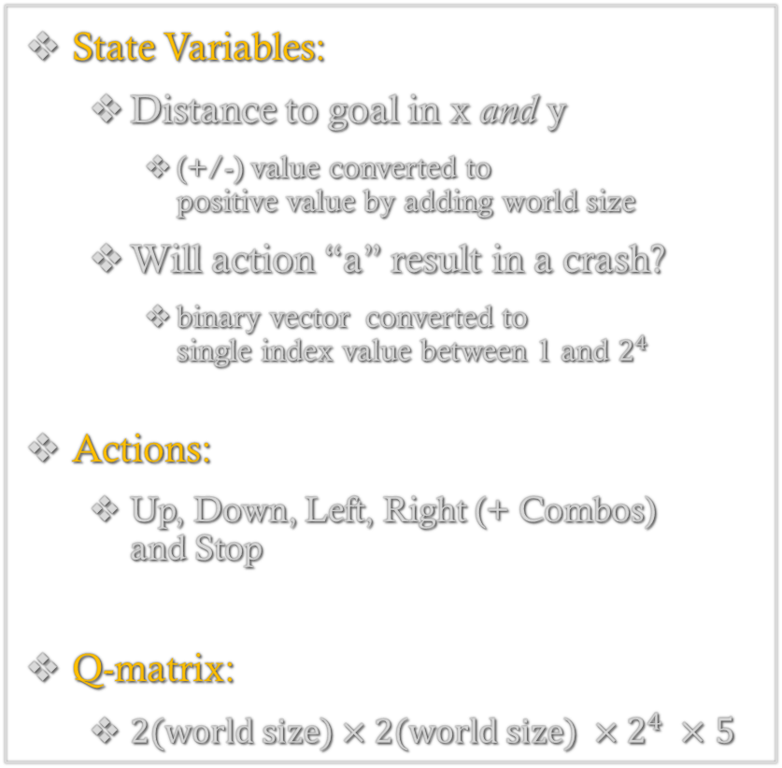
Q-Learning Details:
State Variables:
Distance to goal in x and y
(+/-) value converted to positive value by adding world size
Will action “a” result in a crash?
binary vector converted to single index value between 1 and $2^{4}$
Actions:
Up, Down, Left, Right (+ Combos) and Stop
Q-matrix:
$2(world size)×2(world size) ×2^{4} ×5$
Rewards:
Reached Goal : 2
Collision : -2
Otherwise : 0
Epsilon ( ε ) – “Exploration”:
linearly interpolated between 0.75 and 0.01 based on episode count
Learning Rate ( $\text{α}$):
Inverse to count of state-action pair
Discounting Factor ($γ$): fixed at 0.9

Slide 6
Training Videos:
Notes:
10x10 world
4 dir + stop = 5 act

Slide 7
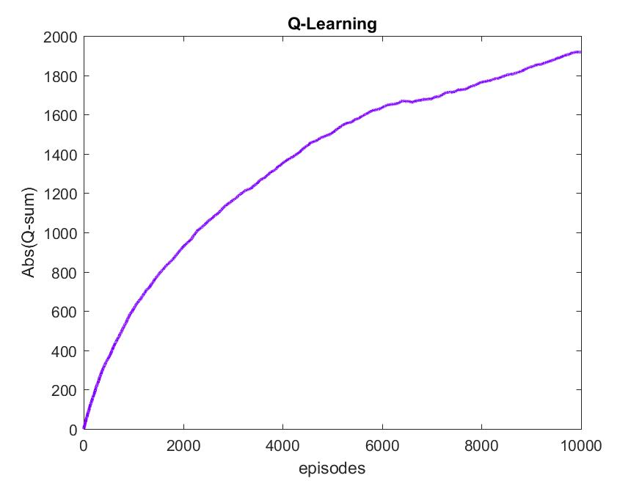
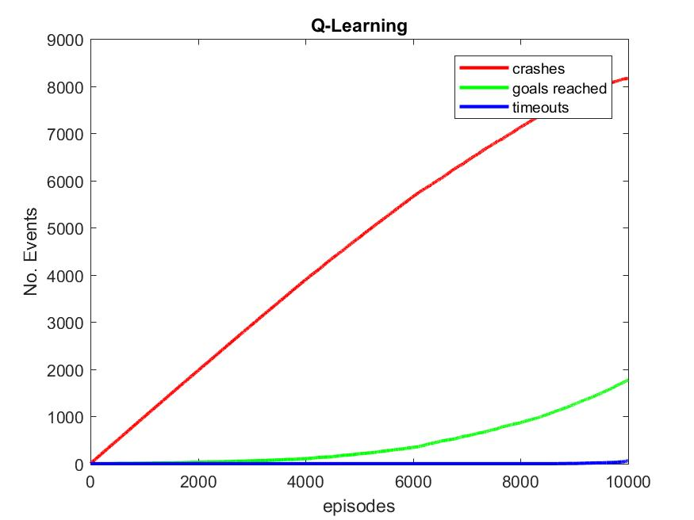
Training Results:
Notes:
Q-table bootstrapped to avoid walls and move toward goal…
Epsilon made dependent upon result of previous episode (large if time-out, small if crash)

Slide 8
Problem with the State
Optimal Q-table NOT Perfect
Avoids cars too much
Stuck … Hit by a car

Slide 9
Moving Forward:
Fix Learning
Cars cannot hit agent (agent can hit cars)
Obstacle Velocities → State
Oscillation Detection → State
Train Longer
100,000+ episodes
Increase Complexity
+ Diagonal Moves
+ Stop Signs & Traffic​ ​Lights
“Continuous” Time & Space
Differential Drive
One-Way vs. Two-Way Streets
Notes:
I wrote a script to create the optimal Q-table based upon the state-parameters and it is not perfect, because the agent avoids the moving obstacles too much and can end up stuck where it will then be hit by a moving obstacle, therefore, I have decided to change the state-parameters to include the velocity of the moving obstacles as well.

Slide 10
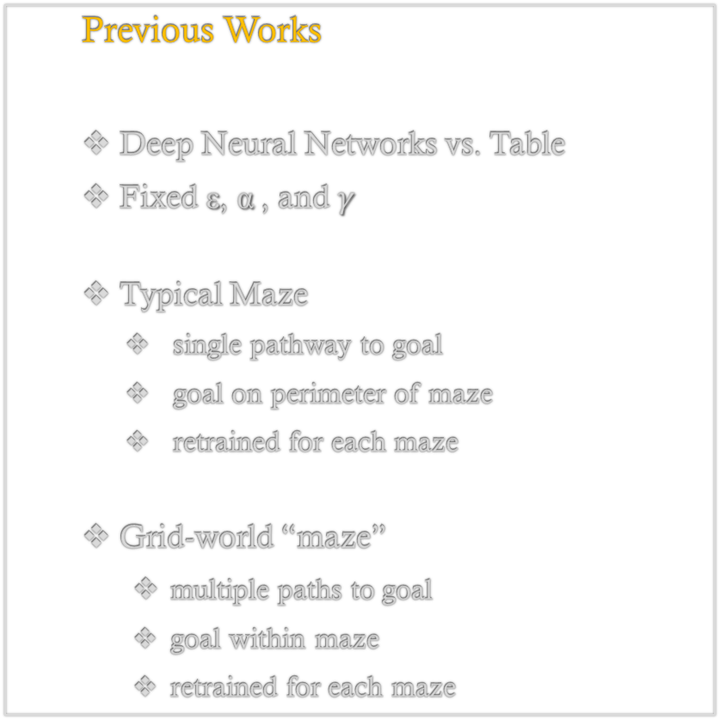
References:
Previous Works
Deep Neural Networks vs. Table
Fixed ε, $\text{α}$, and $γ$
Typical Maze
single pathway to goal
goal on perimeter of maze
retrained for each maze
Grid-world “maze”
multiple paths to goal
goal within maze
retrained for each maze
Previous Works Continued …
Circuit Racing
realistic driving controls
Video-image processing
My Problem
Grid-world “maze”
multiple paths to goal
goal within maze
moving obstacles (& more)
general to all mazes.
I did not reference anyone’s work

Slide 11
Questions?

